Slide 1
The Telemetry of Trust, Using Attestations to Secure Your SDLC w/ Open Source Tools
Jesse Sanford - Software Architect, Autodesk
Jagadish Ramidi - Security Software Engineer, Autodesk
@handle
Notes:
Ok Welcome everyone. Thank you for attending our talk today on how we are using attestations at autodesk to secure our SDLC.

Slide 2


Jesse Sanford
Software Architect, Autodesk
Jesse is a lifelong software engineer focused on site reliability and Infosec. Currently architecting the juncture of platform engineering and security/compliance for Autodesk's Developer Enablement team. He regularly contributes to open source and frequently speaks about his work utilizing it at Autodesk and in the community. When not in front of a computer, he is a backpacker, sailor and continuously delivering parent of two young daughters.
Jagadish Ramidi
Software Engineer, Autodesk
Works as a security software engineer at Autodesk focusing on software composition analysis and supply chain security.
Notes:
I am Jesse Sanford, I am a software engineer at autodesk working on our internal developer platform tooling and secure software supply chain capabilities.
When I am not in front of a computer I like go sail, backpack and spend time with my two young daughters.

Slide 3
Agenda
Level set on S3C (Secure Software Supply Chain)
S3C challenges in practice
Telling the SDLC “trust story”
Attestations!
Demo
How to get started and where we can go
Notes:
Thanks Jagadish, So let’s quickly set the agenda
First we will level set on the state of S3C in practice across the industry
Next we will consider the challenges companies like Autodesk have when applying S3C practices
After that we will do some story telling
And then we will talk briefly about how attestations help tell that story before passing the batton to Jagadish to show some demo attestations and how they can be generated and verified
Finally we will give some pragmatic tips on how you can get started and where we can go from here

Slide 4
Let’s level set…
OSS progress over past few years is good
Standards: (SBOM, SLSA 1.X, SSDF 1.X, IETF SCITT)
Public Good Services: Sigstore, Alpha-Omega project
Major SCM integrations (Github, Gitlab)
Sigstore for package managers and major projects (K8s, NPM, Homebrew)
But internally adoption is slow…
Technology inertia (Legacy / brown field)
Compliance regime deltas
Notes:
So let’s get real about where we are with S3C!
Can I get a quick show of hands of those of you who believe you have robust software supply chain security practices implemented in your organizations?
Anyone SLSA level 3 or across the board? Level 4? Don’t be scared to raise your hand. I won’t call on you!
So that’s about what I expected. We have seen a lot of progress in the open source community,
We have many ratified standards,
We have public good services
Most major SCM providers now have integrations for things like SLSA provenance
Even large package repositories land major projects performing are doing their part
I think the keynote yesterday said that there are over 5000 npm packages with provenance attestations now?
But adoption internally behind organizational walls is still piecemeal. That’s especially true in the enterprise.
And I believe that is because of the difficulty large companies have in changing the way they build software.
We have to deal with existing technology choices and varying compliance requirements. These things can be real impediments at scale!

Slide 5

S3C Challenges
Technology inertia is real!
Continuous M&A
How can we wrap all that diversity?
Adaptable
Encompass the complete SDLC
Notes:
At Autodesk we are no different.
We have our own technology inertia,
As an example you may have seen my talk at OSS Summit NA 2023 about adapting classic Jenkins CI for artifact signing
We also have a continuous stream of acquisitions that bring their own diversity to the table year over year
How can we wrap all that diversity?
We need something that is adaptable
Something that can encompass the complete SDLC from soup to nuts!

Slide 6




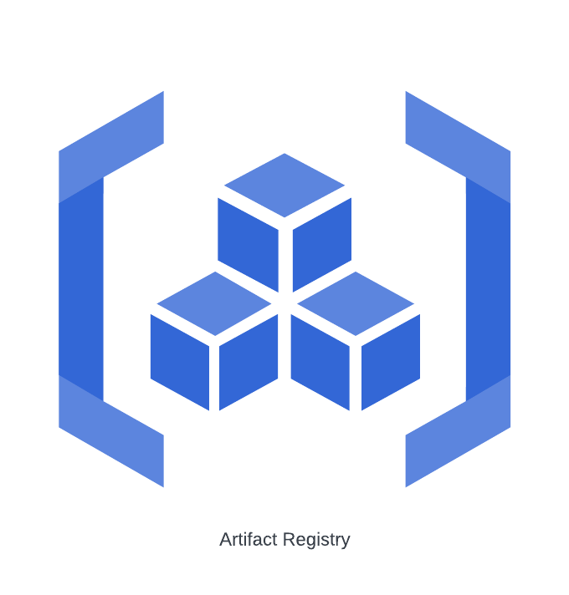

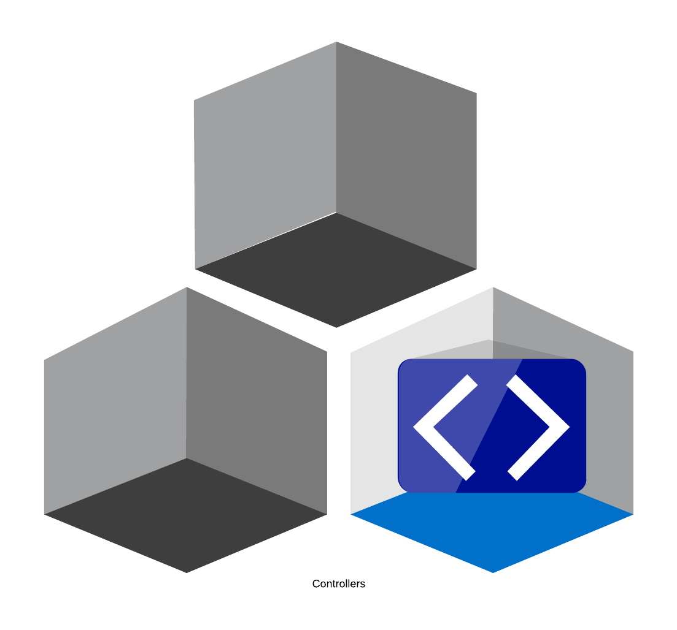



Autodesk SDLC overview
Autodesk Reference Arch impl
Consumption (Runtime)
Integration
Ideation
Source Integrity
Build Integrity
Deploy/Runtime Integrity
Notes:
So let’s talk about that SDLC
Here is an example of the life of a software artifact at autodesk.
Notice how it has a path that it takes from ideation to consumption or RUNTIME.
How can we describe the path that a particular build takes that describes its life cycle in a “TRUSTFULL” way?

Slide 7
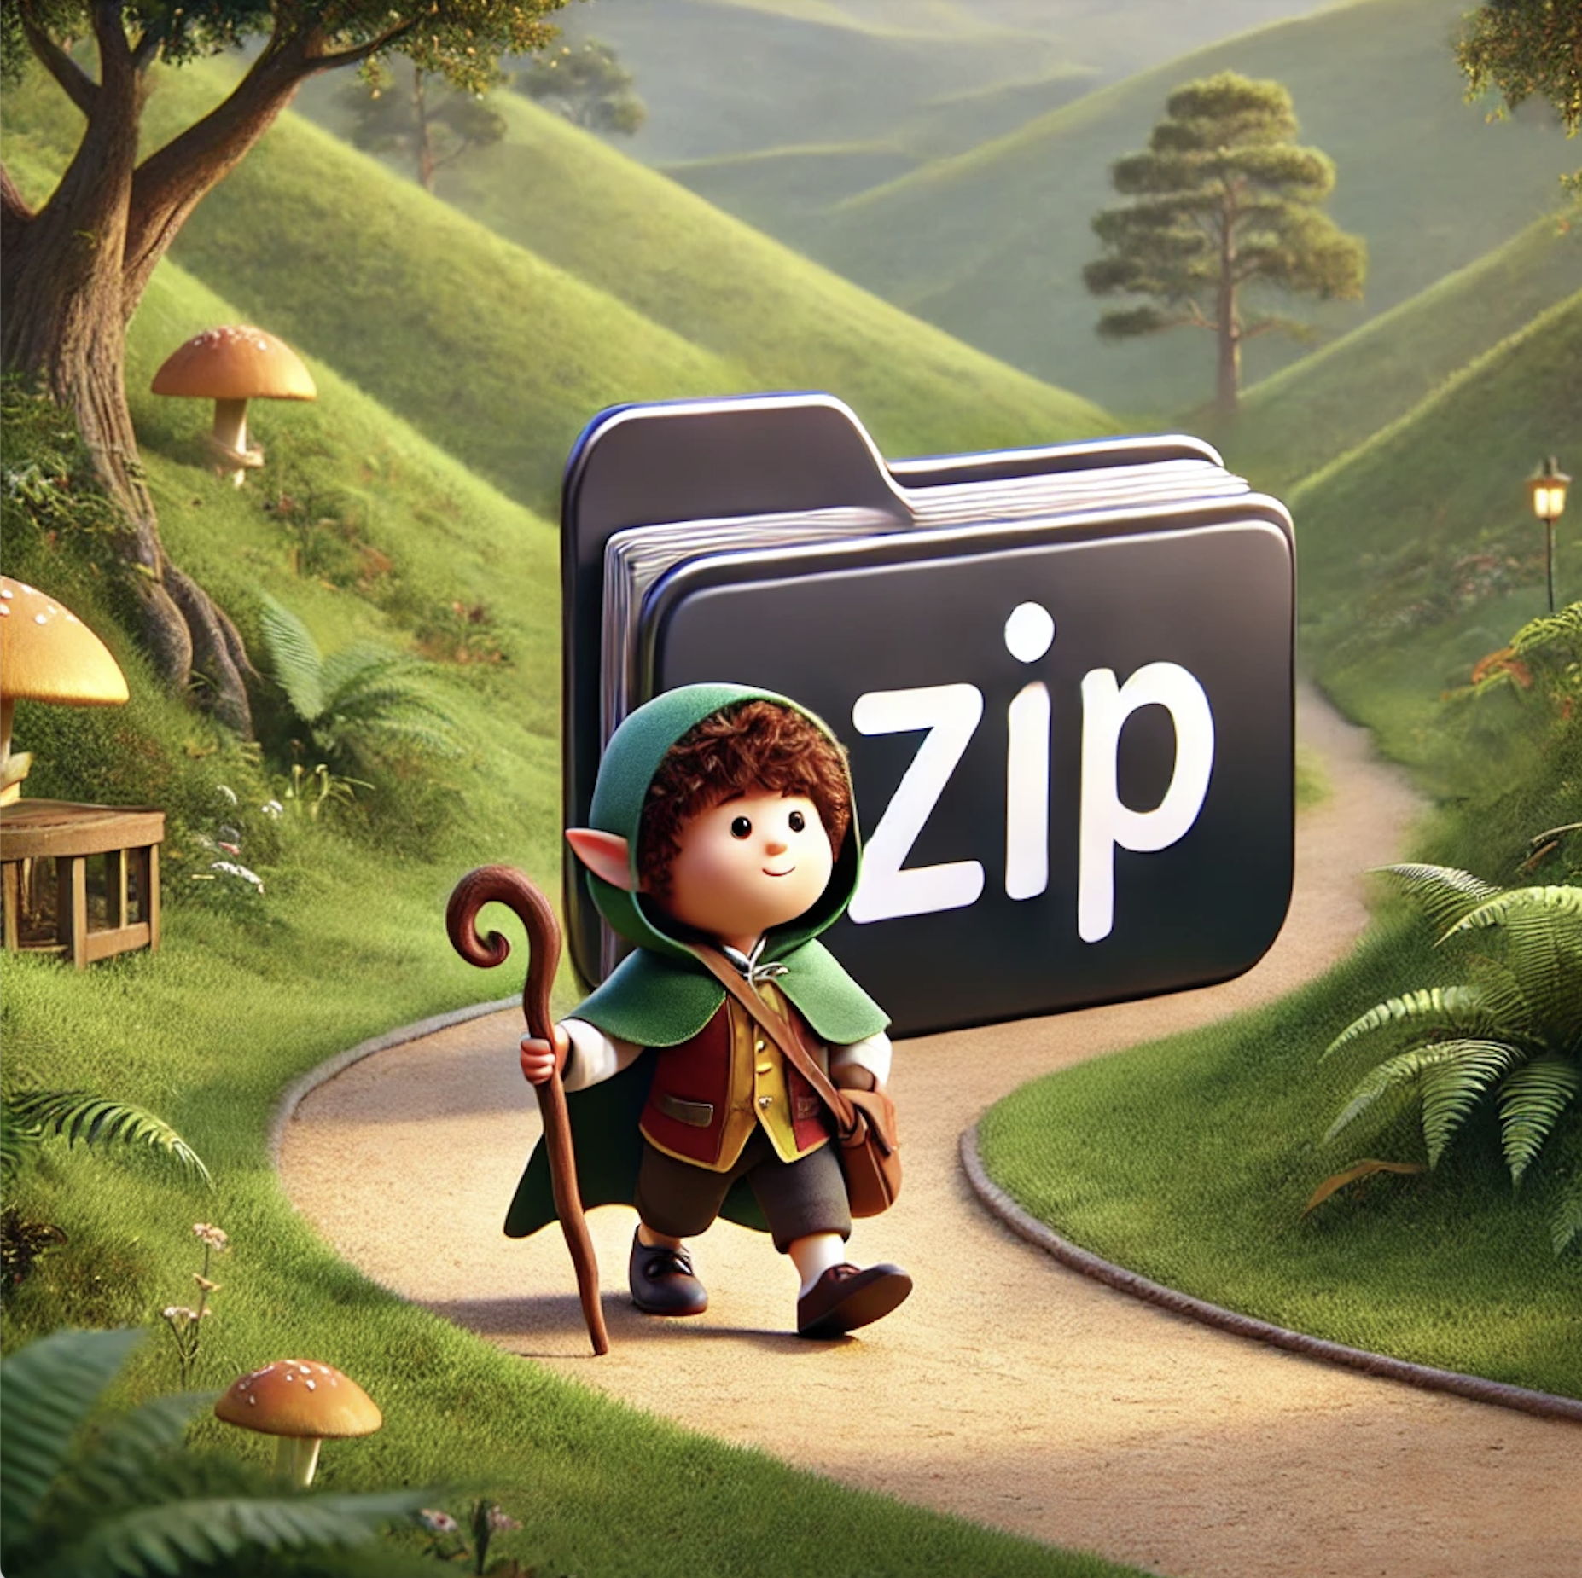
THE BUILD… An unEXPECTED journey
(And trusted!)
Notes:
So as I mentioned in the lead in, I am the father of two young girls…
And as most parents of young children I read a lot of stories.
LOTS of stories…
Hundreds of them over the past decade.
And in thinking about the path that a software build takes, it reminded me of a story!
A story of a journey, The journey of a particular piece software through a development lifecycle

Slide 8

Telling the SDLC “story”
For a particular build, let’s tell it’s story:
Every build is it’s own book
Each phase is another “chapter”
Each step in a phase (like CI) is another page
Each page can have multiple “statements”
The story
of Build #37
The story
of Build #37
Notes:
So what would that story look like?
Well to start with, each build can be its own book
Then we can have each phase in the build like CI/CD be another chapter in the book
Then for each step in a phase, (like a build step) we can have another page
Then on each page we can have multiple statements about the step
The statements are made about what is expected from that step
Ultimately they are the signals we use to judge if the story is good or TRUSTFULL

Slide 9

The Story as SDLC Signals
Jenkins Build
Artifact SBOM
GIT Commits
Runtime CSPM
Jira Issue
Book of Build #37
Notes:
If we think about the story as an ARC,
We can see how the signals combine into the pages and the pages become the chapters in our Book

Slide 10
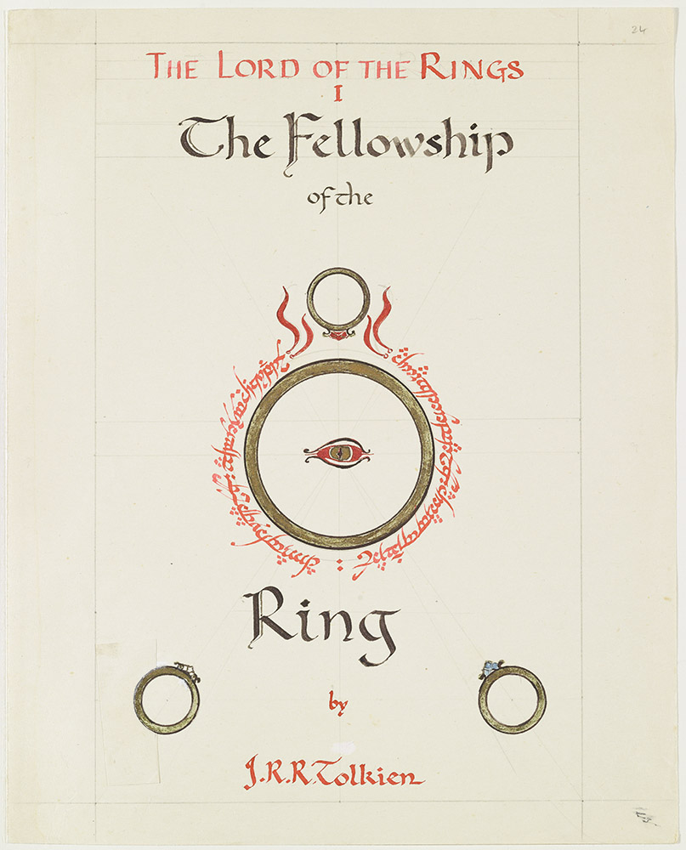
Telling the SDLC “story”
We can stop the story if we don’t like it
We can skim the book
Focus on pages that build “trust” faster
Then go back and embellish
Notes:
And Just like reading a book, we can stop the story if we don’t like it.
And on that. When my oldest was a bit younger we attempted to read the lord of the rings…
And she didn’t like it at first. It was too scary and dark, a little too serious, so we put it down for about a year
Then later when when she was older we picked it back up, she was much more interested in it
and she made me read it to her
TWICE!
And that’s OK, Sometimes we needed to MATURE a bit, sometimes we need more understanding before moving forward in a story!
We can also skim the book, we don’t need every step, just enough to tell a “trustfull” story.
Start with the signals that help the story become more “trusted” faster. Then if interested, go back and embelish

Slide 11



Collecting the story of a build!
Key:
Trust Telemetry
Attestation Instrumentation
Notes:
So back to our SDLC and our story,
We can only tell the EXPECTED journey of our builds.
We don’t want to rely on anything UNEXPECTED
So we have to instrument the places we expect to build trust on.
The different parts of the process that produce signals that we can use to decide if a particular build is trustful
These signals are what we have started calling our “Trust Telemetry”

Slide 12
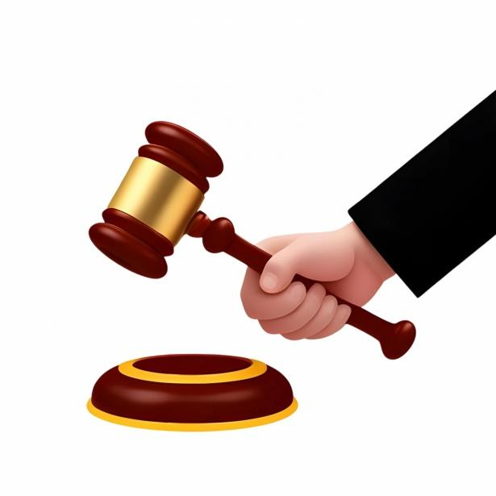
The “Trust Telemetry” of the Story
We can start to judge builds against expectations
Specified through policies
Policies for each phase or even each step
Only gate when risk requires
Manual review when things look strange?
Notes:
At scale across all builds in an SDLC for a particular piece of software over time,
The signals become telemetry for the trustworthiness of a build.
With this “Trust Telemetry” we can start to judge builds against our expecations that we specify through policies
We can use policies for each phase, or even each step to decide if we want to proceed or abort because the telemetry is indicating things are looking untrustworthy.
And we can decide based on the risk profile of where the artifact will be used whether or not to gate with policy at all.
Maybe we just decide to institute a manual review before allowing things to proceed?

Slide 13




Daily Trust Telemetry
Notes:
And why not start to create policies on trust telemetry? This concept is not new.
We use Trust Telemetry for automating our daily lives already.
How many of you have a smart watch?
Do any of you use it to unlock your computer when you are near by?

Slide 14



Daily Trust Telemetry
Notes:
Or the inverse, how many of you get prompted to remember to lock your doors when you leave your house by your smart locks or home automation?

Slide 15

The Signals of Trust
A snapshot of SDLC
Each signal is a statement
Something we expect to happen
But it must be instrumented!
The statements are “attested” to
Just like testifying to a statement in a court
Notes:
Trust telemetry provide us with the signals of trust that we need to understand if our expectations are being met
They are a snapshot of the truthfulness of our SDLC
Each signal is a statement about an expected part of our process that we instrumented for visibility
Just like in court where a witness gives testimony under oath
our statements are sworn to or ATTESTED by our instrumented steps in our SDLC

Slide 16

Attestations provide the context
Individually, they provide little trust
In aggregate, stronger than the sum of their parts
Brings picture into focus
More context = Smarter Decisions
Notes:
Individually they may only give small bits of trust, but in aggregate they build up to something much stronger than the sum of their parts.
They provide a context that can be cryptographically verified. This is powerful!
They bring the picture into focus
Which allows us to make smarter more informed policy decisions.

Slide 17

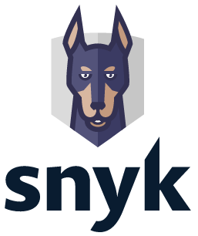


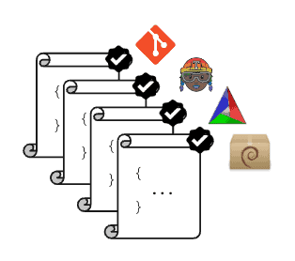



Attestations bridge the diversity
Notes:
By standardizing on a metadata format for the statements made about our SDLC,
We can start to bridge the broad diversity of the totality of it’s processes.
Think about how many static analysis tools that could exist in a company that builds as much software as autodesk.
All of those tools have their own proprietary metadata and APIs. They store the output of their scans in their own database backends.
How can we make policies that span all of them?
How can we future proof the policies so that we can change tools out later?
How can we support mergers and acquisitions in a way that doesn’t require rewriting the same point solutions over and over?
Attestations and their “Types” help bridge the diversity by bringing well thought, well understood and negotiated semantics about their meaning and as long as the output of a tool can map to those semantics, the attestation “Types” can wrap it.

Slide 18
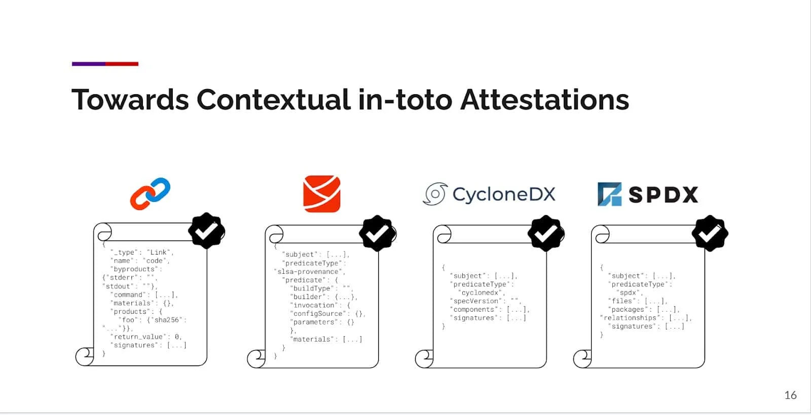
The API of DevSecOps?
ITE-10: https://github.com/in-toto/ITE/blob/master/ITE/10/README.adoc
Blog post: https://www.cncf.io/blog/2023/08/17/unleashing-in-toto-the-api-of-devsecops/
Kubecon EU 2023 Preso: https://www.youtube.com/watch?v=ezV_oWBPqKw
Notes:
So when we start to think about how attestations can help span all of these security tools and to help abstract the metadata they produce,
We get into this realm of the attestations themselves becoming a kind of API or framework for helping aggregate all of the value of the individual tools
It’s very similar to other tools that aggregate functionality and mask underlying implementation details bringing diverse ecosystems together in a common patterned way..
Think Terraform
Or what about the Kubernetes Operator pattern?
There is a Kubecon EU talk from 2023 and a corresponding blog post about this by Aditya Sirish and Cole Kennedy.
I highly recommend watching and reading. You can find the links in the slide here.

Slide 19

Focus on Attestations
“Claims” about a process
Metadata
Time stamped
Persistent
Verifiable
Examples:
in-toto attestations
SCITT statements
Notes:
So what is an attestation?
At their simplest, they are the expected “claims” about a process
Those claims have metadata associated with them
And they are time stamped
Hopefully persistent and immutable
They are cryptographically verifiable.
Some common examples are in-toto attestations and the less familiar SCITT “statements” from the IETF

Slide 20
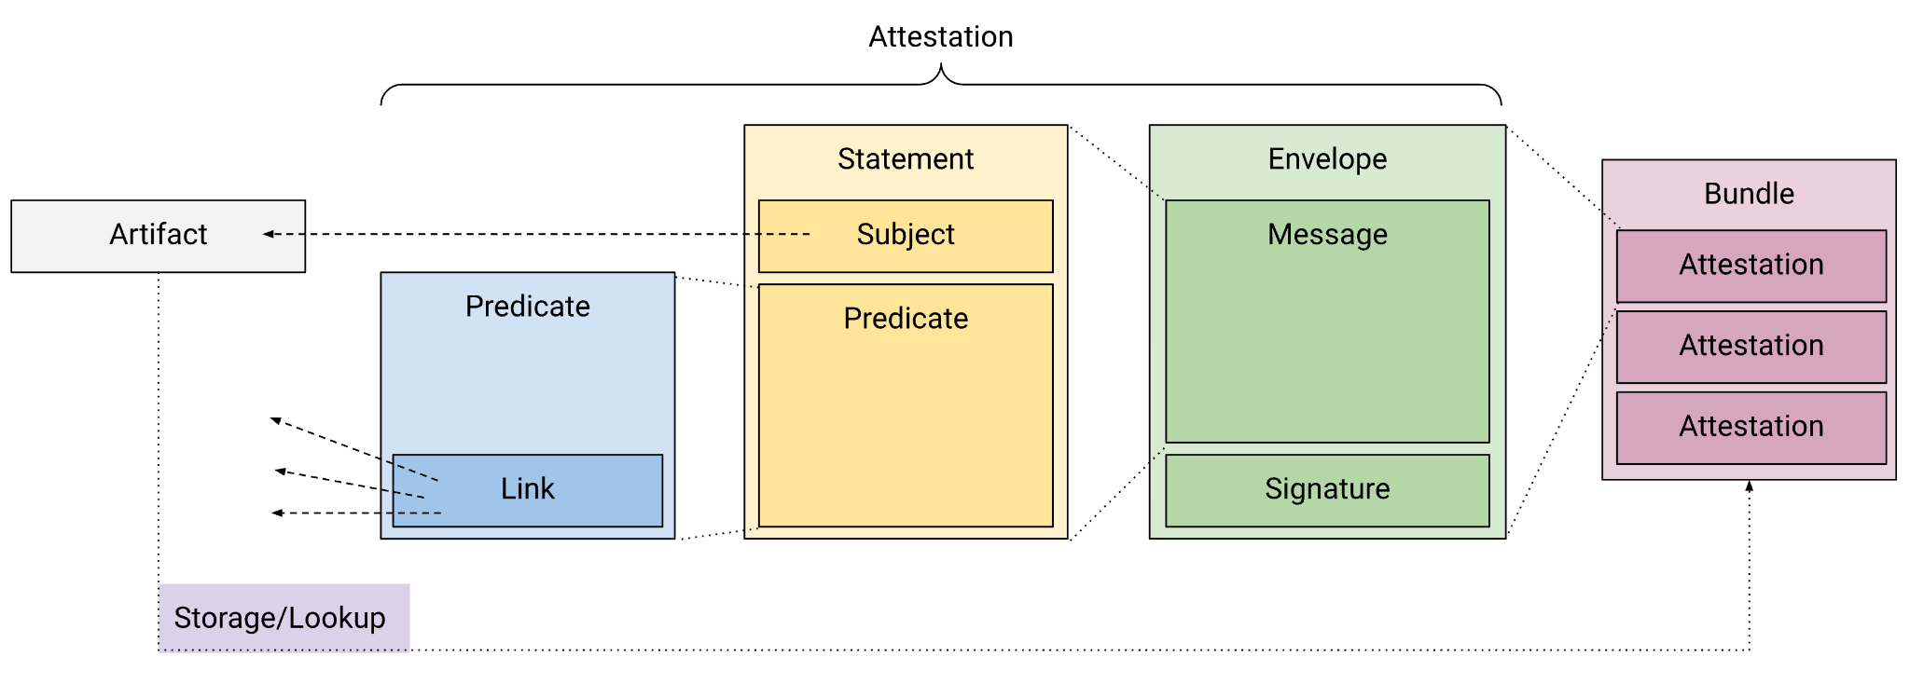
Focus on attestations ctd
Notes:
Here is a view of the composition of attestations taken from the in-toto docs.
Notice that attestations are usually linked to an artifact or “subject”
By linking them in this way, you can aggregate them based on the artifact
and if you invert that link, you can query them returning everything for a particular subject

Slide 21
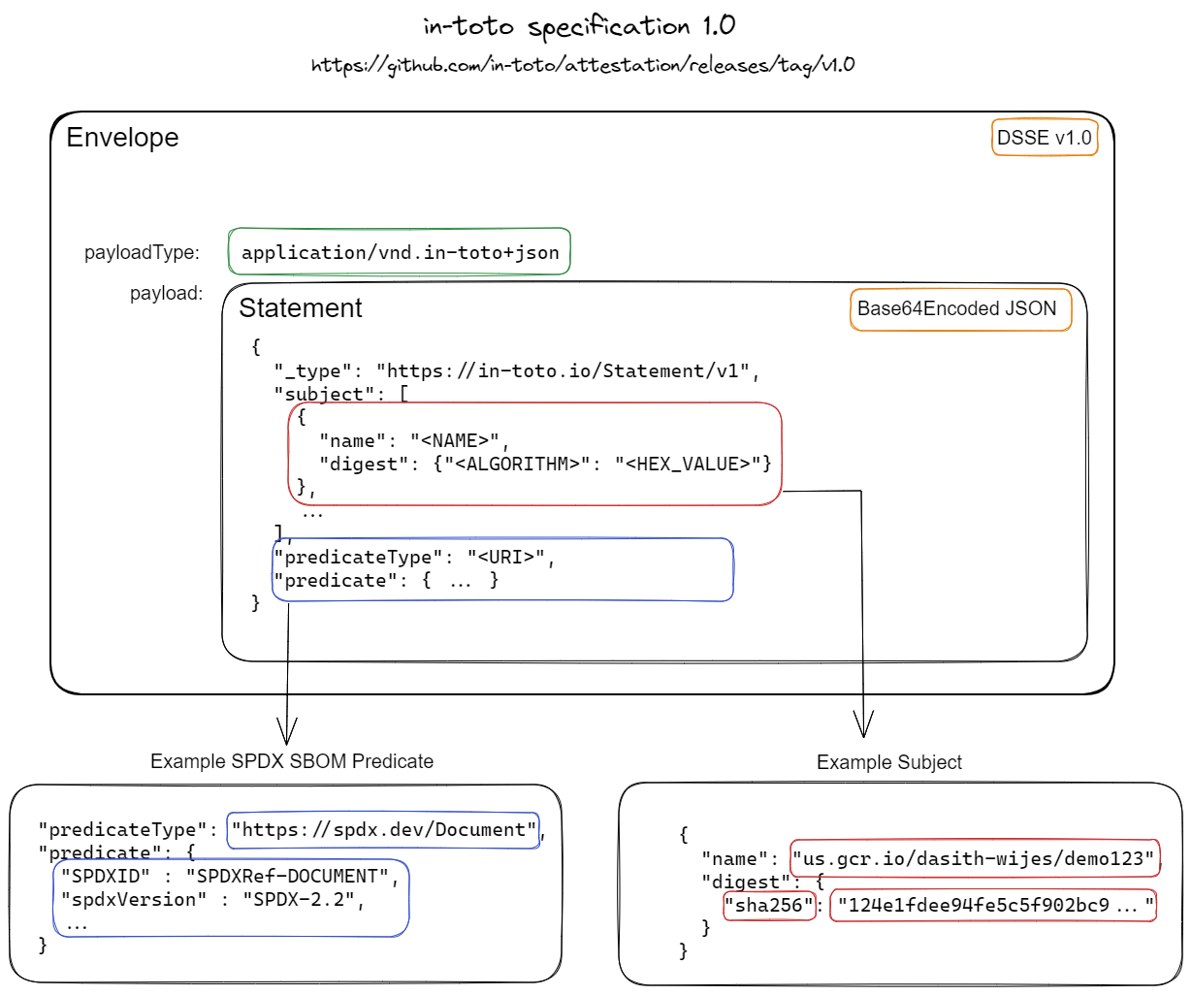
The in-toto Attestation
Predicate: Defines an action taken
Statement: Binds the action to the subject of the action.
Envelope: Enables verification and ultimately trust.
Notes:
Here is the in-toto attestation in detail
We have the “predicate” which defines an action taken
We have the “statement” which binds that action to a subject like a build artifact
And then we have an envelope, which wraps the whole thing and provides cryptographic guarantees

Slide 22
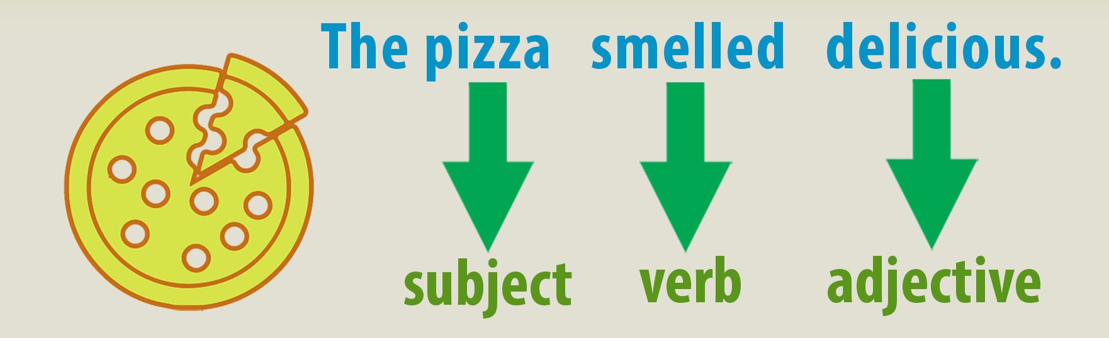
Predicates = the “types” of actions
“The software was scanned”
Many common predicates or “types”
SBOM
SLSA Provenance
Test results
Runtime Traces
Custom predicates
Escape hatch
Semantics are hard
Notes:
To me, the most interesting part of the attestation payload is the “predicate”
That’s where the semantics of what is inside the attestation come into play.
It’s what tells you “what happened” to a particular subject.
For instance, We can say that for a particular predicate that some software “was scanned”
Or that a pizza “SMELLED DELICIOUS”
Or Jesse is wearing his smart watch!
There are many common in-toto attestation predicate types
Also you can create custom predicates if there isn’t a type that suits your use.
Remember though that the hard part is defining the semantics of the predicate so that it’s useful for more than just one small use case or specific tool

Slide 23
Let’s look at example attestations
{"_type": "https://in-toto.io/Statement/v1",
"subject": [...],
"predicateType": "https://slsa.dev/provenance/v1",
"predicate": {
"buildDefinition": {
"buildType": string,
"externalParameters": object,
"internalParameters": object,
"resolvedDependencies": [ ...#ResourceDescriptor ],
},
"runDetails": {
"builder": {
"id": string,
"builderDependencies": [ ...#ResourceDescriptor ],
"version": { ...string },
},
"metadata": {
"invocationId": string,
"startedOn": #Timestamp,
"finishedOn": #Timestamp,
},
"byproducts": [ ...#ResourceDescriptor ],
}}
SLSA Provenance:
#ResourceDescriptor: {
"uri": string,
"digest": {
"sha256": string,
"sha512": string,
"gitCommit": string,
[string]: string,
},
"name": string,
"downloadLocation": string,
"mediaType": string,
"content": bytes, // base64
"annotations": object,
}
Notes:
One of the most common types is the SLSA Provenance Attestation.
If you have interacted with the SLSA framework, you have probably seen this attestation schema before.
If you aren’t familiar with the concept of “Provenance”, It just tells you about how something came to be and where it came from.
This attestation focuses on the build process and how artifacts are built.
SLSA provenance attestation on a high level tells u the journey of the specific command executed on the build machine.
It’s very useful to help document the way that artifacts are built in your CI pipelines.
It helps with just that… provenance!
High level its holds primarily 3 types of metadata. 1. BuildDefinition: The command being executed, the command used, the files required for successful execution
2. Run Details: Build tools utilized
3. Byproduct: metadata of the artifact generated.

Slide 24
Other interesting ones…
SBOM:
Vuln Scan:
{ "_type": "https://in-toto.io/Statement/v0.1",
"subject": [{ ... }],
"predicateType":"https://cyclonedx.org/bom/v1.4",
"predicate": {
"bomFormat": "CycloneDX",
"specVersion": "1.4",
"serialNumber": "urn:uuid:3e671687-395b-41f5-a30f…",
"version": 1,
"components": [
{
"type": "library",
"name": "acme-library",
"version": "1.0.0"
}
]
...
}
}
{ "_type": "https://in-toto.io/Statement/v0.1",
"subject": [{...}],
"predicateType": "https://cosign.sigstore.dev/attestation/vuln/v1",
"predicate": {
"invocation": {
"parameters": [],
// [ "--format=json", "--skip-db-update" ]
"uri": "",
"event_id": "",
"builder.id": "" …
Notes:
Here we also see SBOM attestations and vuln scan attestations
You can imagine what those contain!
As I said earlier there are many already existing predicate types that can be used.
We just need to generate them in our pipelines in a trustful way.
And there are tools to help us with that.
Now I will hand it over to Jagadish to take you through some of them…

Slide 25

Generating Attestations
A few tools can create attestations:
in-toto suite (in-toto-run, in-toto-record, in-toto-sign)
Requires Layouts
Creates Link files
witness
Does not need layouts
Automated data collection
Leverages in-toto attestations
cosign
Part of the sigstore suite
Can take in attestation as json
Store with container image in OCI registry
slsa-attestor
Specifically for slsa provenance
Notes:
To generate attestations we have a few choices at this point.
Each with their own benefits and drawbacks…
We wanted to balance the benefits, drawbacks and focus on the developer friction aswell.
Enhancing legacy pipelines is a costly process needing a lot of engineering effort.
We have roughly 5-6 Lakh builds running in a week, how can we seamlessly introduce/ encapsulate them into all of those pipelines?
How can we reduce the dev effort needed? How can we automate the data collection as much as we can?
This is where platforming the build pipelines comes into picture and we have been making great strides in this direction for past few years. And witness is a perfect fit in this usecase.
Witness can generate multiple statements in a single execution collecting whatever it can during the execution. Its execution is simple and straightforward with minimal learning curve. Also great maintainers with common vision.

Slide 26

Spotlight on Witness
Allows us to declare policies independently of build pipeline design
Automated Data collection to reduce developer friction.
Allows separation of concerns from software developers and policy owners
Important when security and compliance teams need ownership over policy
Notes:
And autodesk has chosen to use witness
Witness is an opensource tool developed by testifySec and donated to In-Toto.
Witness has a unique approach in the way it generates stores and verifies an attestation for an artifact.
Its ability to have the policies stored in a centralized mode decouples sdlc and security/compliance workflows.
This helps security and compliance folks to review and update these from time to time While reducing the need to update the pipelines.

Slide 27




But where are they stored?
Archivista is a graph and storage service for in-toto attestations.
Enables the discovery and retrieval of attestations for software artifacts.
Notes:
An artifact goes through multiple phases before its ready for deployment/distribution. All these phases generate an attestation of its own. Its nearly impossible to store all these into a single collection.
Now we end up with multiple attestations for different stages of sdlc.
In case of a single build pipeline we end up with a bundle of pages instead of a book. In terms of multiple builds we get a lot more of these and storing and retrieving the pages in a sensible way is going to be a nightmare.
We use archivista to solve this problem. Archivista is an opensource tool belonging to the In-Toto suite
Archivista is a graph and storage service for [in-toto](https://in-toto.io) attestations. Archivista enables the discovery
and retrieval of attestations for software artifacts.
When an attestation is uploaded to Archivista it will store the entire attestation in a configured object store as well
as scrape some data from the attestation and store it in a queryable metadata store. This metadata is exposed through a
GraphQL API. This enables queries such as finding all attestations related to an artifact with a specified hash or
finding all attestations that recorded the use of a specific dependency.
Explain how this generates a tree of supplychain

Slide 28

Verifying Attestations
And their verifying pairs:
in-toto-verify
Verifies layouts and link files
witness verify command
Verifies against witness (rego) policies
cosign verify
Validates attestation signatures
Can validate with cue or rego policies
slsa-verifier
Verifies slsa provenance attestations
Limited to provenance specifics
Builder id
Src code repo info
Notes:
And on the flip side we have the pair verification tooling…
If generating attestations is a step 1 of the process, those are just a noise if we dont have a comprehensive storage and verification mechanisms.
These verifications could be as simple as verifying build machine or commit by a developer or as complicated as building gates for everything or anything.
With these attestations we should be able to verify ideation to creation of an artifact was done via a trusted source.

Slide 29
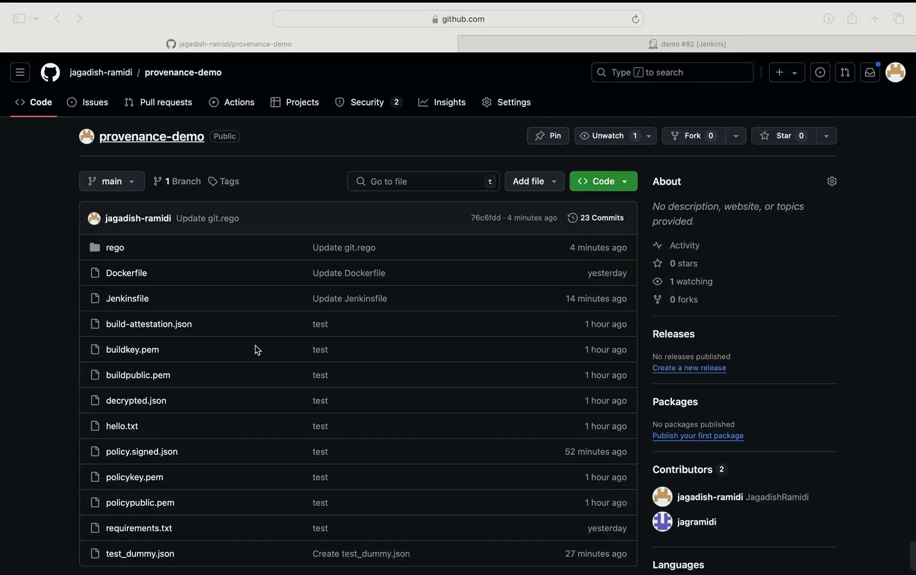
Now let’s see an attestation get generated

Slide 30

Diagram of the build SDLC as attestations in graphql viz
Notes:
Show the story actually told as a picture of attestation nodes in a graphql vis, show how we can traverse the graph following the links between the attestations
This will be included in the video presentation.

Slide 31
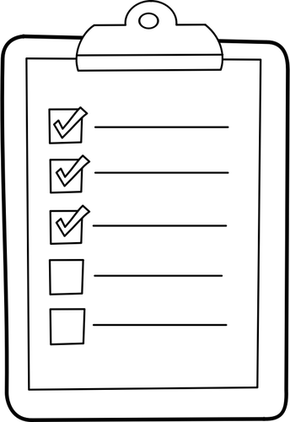
How start telling your SDLC stories?
Start with accounting your processes
Threat modeling helps!
Find places that you can instrument
The common “predicate types” are obvious
Sort by those that instill greatest “trust”
Instrument and write policy to use them
Repeat!
Notes:
You can use existing threat models if they are up to date, but never assume they are!
Build processes change all the time!

Slide 32

Where can we take this?
Centralized policy evaluation
More on this next…
AI/ML
Trained on data lake
Augment with sw quality and incident data
Enable earlier “trust” decisions
Notes:
So where can we take this?
Well to start with, we can start by creating a policy evaluation service… but more on that next
We can also start to use our trust telemetry data-lake as a training set for Machine Learning.
If we have information at scale about what attestations lead to trustful builds we possibly start to produce warnings / policy decisions earlier in the SDLC process
This becomes even more effective if we augment that training data with software quality data from developer productivity tools
And Incident data for things like change induced outages or even security incidents

Slide 33

Centralized Policy Decisions
Central data lake w/ graph API is foundational
Policy evaluation API
Policy becomes pluggable
Diverse environment becomes easier
Avoid policy distribution issues!
Strong separation of concerns
OOB policy execution
Backtest policies (w/out re-running pipelines)
Notes:
So about centralized policy decisions…
We would have loved to present in detail about this today… however there simply isn’t time in a 30 min slot
So we will have to leave this till next years Summit, Take note selection committees!
However quickly, know that the
Central data lake w/ graph API is the foundation
With that, we can make the evaluation of policies into an API where you just pass in your artifact and the phase and step you are in..
“Evaluation API” policy decisions can simply be boolean response
Or Possibly richer giving a “% confidence” or “requires review” response
And now Policy evaluation invocation becomes pluggable, developers can just drop in the calls to the evaluation API
Don’t need to slow or block ideation
This also makes managing policies in such a diverse environment easier.
We Don’t need to worry about policy distribution
And this also Enables the separation of concerns from policy owners and software developers
Developers write software
Policy Owners write policy
Finally we can backtest policies against the data lake without needing to re-run pipelines to execute the policies IN BAND
which makes maintaining policies over time much easier
Can do things like dry run policies to see which builds they would influence.

Slide 34
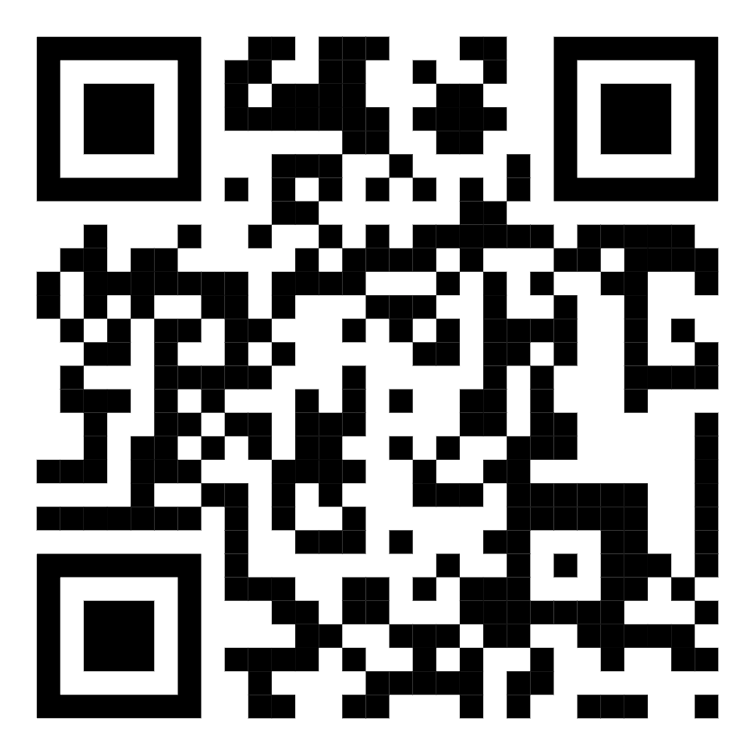
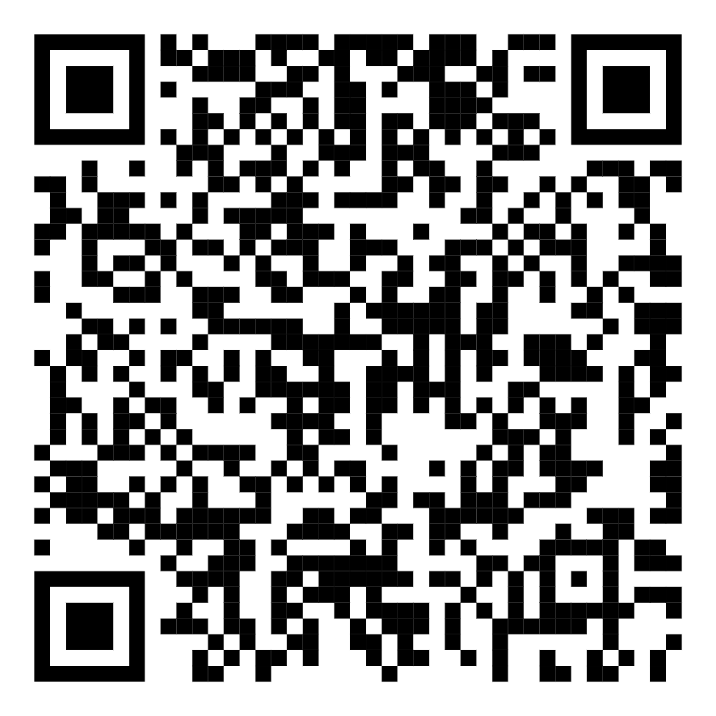
Thank you!
KCNA 24 Talk Coming SOON! Secure by Design CI/CD: Practical Insights from Adobe and Autodesk - Vikram Sethi, Adobe Inc. & Jesse Sanford, Autodesk
Slides/demo and links:
QUESTIONS?
https://sched.co/1i7lS
Follow us on linkedin!
/in/jessesanford
/in/jagadishramidi/
https://github.com/jessesanford/scscon-japan-2024
Notes:
Thanks to Gus Tabares for his continued leadership support and trust in our vision Thanks to Uday Bhaskar and Joshua Wang for their help developing this vision and implementing the solution with us.

